Slide 1

Chapter 15
Franchising
Bruce R. Barringer
R. Duane Ireland
15-<number>

Slide 2
Chapter Objectives
1 of 2
Explain franchising and how it differs from other forms of business ownership.
Describe the difference between a product and trademark franchise and a business format franchise.
Explain the differences among an individual franchise agreement, an area franchise agreement, and a master franchise agreement.
Describe the advantages of establishing a franchise system as a means of firm growth.
6-<number>

Slide 3
Chapter Objectives
2 of 3
5. Identify the rules of thumb for determining when franchising is an appropriate form of growth for a particular business.
6. Discuss the factors to consider in determining if owning a franchise is a good fit for a particular person.
7. Identify the costs associated with buying a franchise.
8. Discuss the advantages and disadvantages of buying a franchise.
15-<number>

Slide 4
Chapter Objectives
3 of 3
9. Identify the common mistakes franchise buyers make.
10. Describe the purpose of the Franchise Disclosure Document.
15-<number>

Slide 5
Introduction to Franchising
Introduction
  Franchising is growing in popularity.
  Nearly 910,000 franchise outlets operate in the U.S.
  Franchises account for 1/3 of all retail sales in the U.S.
History
  The word “franchise” comes from an old dialect of French and means privilege or freedom.
  Many of the most popular franchises, including KFC (1952), McDonald’s (1955), and H&R Block (1958) started as early as the 1950s.
15-<number>

Slide 6
What is Franchising?
Franchising
  Franchising is a form of business organization in which a firm that already has a successful product or service (franchisor) licenses its trademark and method of doing business to another business or individual (franchisee) in exchange for a franchise fee and an ongoing royalty payment.
  Some franchisors are established firms (like McDonald’s) while others are first-time enterprises being launched by entrepreneurs.
15-<number>

Slide 7
Two Types of Franchise Systems
1 of 3
Product and Trademark Franchise
  An arrangement under which the franchisor grants to the franchisee the right to buy its products and use its trade name.
  This approach typically connects a single manufacturer with a network of dealers or distributors.
    For example, General Motors has established a network of dealers that sell GM cars and use the GM trademark in their advertising and promotions.
    Other examples of product and trademark franchisors include agricultural machinery dealers, soft drink bottlers, and beer distributorships.
15-<number>

Slide 8
Two Types of Franchise Systems
2 of 3
Business Format Franchise
  An arrangement under which the franchisor provides a formula for doing business to the franchisee along with training, advertising, and other forms of assistance.
  Fast-food restaurants, convenience stores, and motels are well-known examples of business format franchises.
    Business format franchises are by far the most popular form of franchising, particularly for entrepreneurial firms.
15-<number>

Slide 9
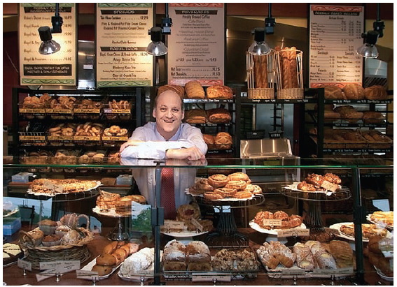
Two Types of Franchise Systems
3 of 3
Panera Bread is an example
of a business format franchise.
Panera provides its franchisees
a strong brand and a method
for doing business.
In return, each franchisee must
pay an initial franchise fee and
ongoing royalties.
15-<number>

Slide 10
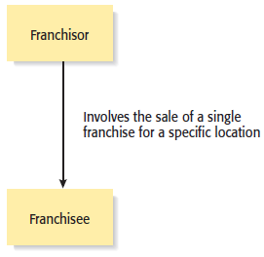
Types of Franchise Agreements
1 of 3
Individual Franchise Agreement
15-<number>

Slide 11
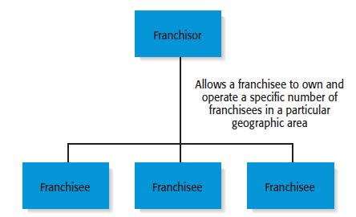
Types of Franchise Agreements
2 of 3
Area Franchise Agreement
15-<number>

Slide 12
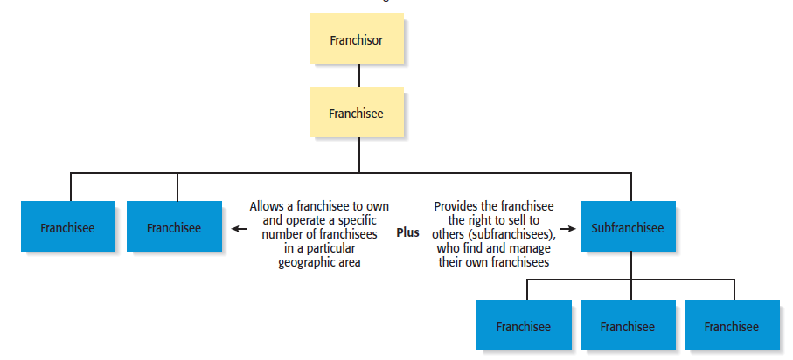
Types of Franchise Agreements
3 of 3
Master Franchise Agreement
15-<number>

Slide 13
When to Franchise
From the Franchisor’s Point of View
1 of 2
Approach Franchising With Caution and Care
  Establishing a franchise system should be approached carefully and deliberately.
  Franchising is a complicated business endeavor, and an entrepreneur must look closely at all its aspects before deciding to franchise.
Regulations
  An entrepreneur should also be aware that over the years a number of fraudulent franchise organizations have come and gone and have left financially ruined franchise owners behind.
15-<number>

Slide 14
When to Franchise?
2 of 2
When Is Franchising Most Appropriate?
  Franchising is most appropriate when a firm has a strong or potentially strong trademark, a well-designed business method, and a desire to grow.
  A franchise system will ultimately fail if the franchisee’s brand doesn’t add value for customers and its business method is flawed or poorly developed.
15-<number>

Slide 15
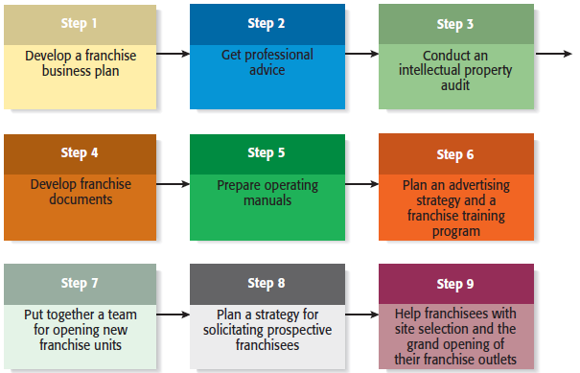
Steps to Franchising a Business
15-<number>

Slide 16
Qualities for Look for in Prospective Franchisees
Good work ethic.
Ability to follow instructions.
Ability to operate with minimal supervision.
Team oriented.
Experience in the industry in which the franchise competes.
Adequate financial resources and good credit history.
Ability to make suggestions without becoming upset if the
suggestions are not adopted.
Represents the franchisor in a positive manner.
15-<number>

Slide 17
Ways Franchisors Can Develop the Potential of Their Franchisees
Provide mentoring that supersedes routing training.
Keep operating manuals up-to-date.
Keep product, services, and business systems up-to-date.
Solicit input from franchisees to reinforce their importance in
the larger franchise system.
Encourage franchisees to develop a franchise association.
Maintain the franchise system’s integrity.
15-<number>

Slide 18
Advantages and Disadvantages of Franchising As a Method of Business Expansion
Advantages
Disadvantages
Rapid, low-cost market expansion.
Income from franchise fees and
royalties.
Franchisee motivation.
Access to ideas and suggestions.
Cost savings.
Increased buying power.
Profit sharing.
Loss of control.
Friction with franchisees.
Managing growth.
Differences in required business skills.
Legal expenses.
15-<number>

Slide 19
Buying a Franchise
From the Franchisee’s Point of View
1 of 3
Buying a Franchise
  Purchasing a franchise is an important business decision involving a substantial financial commitment.
  Potential franchise owners should strive to be as well informed as possible before purchasing a franchise and should be aware that it is often legally and financially difficult to exit a franchise relationship.
15-<number>

Slide 20
Buying a Franchise
2 of 3
Answering the following questions will help determine if franchising is right for you
Are you willing to take orders? Franchises are typically
very particular about how outlets operate.
Are you willing to be part of a franchise “system” rather
than an independent businessperson?
How will you react if you make a suggestion to your
franchisor and your suggestion is rejected?
What are you looking for in a business? How hard do you
want to work?
15-<number>

Slide 21
Buying a Franchise
3 of 3
Answering the following questions will help determine if franchising is right for you
How willing are you to put your money at risk?
How will you feel if your business is operating at a net
loss but you will have to pay royalties on your gross
income?
15-<number>

Slide 22
The Costs Involved With Buying a Franchise
1 of 3
Initial Franchise Fee
  The initial fee varies depending on the franchisor.
Capital Requirements
  The costs vary but may include the cost of buying real estate, the cost of putting up a building, the purchase of inventory, and the cost of obtaining a business license.
Continuing Royalty Payment
  Typically 3% to 7% of monthly gross income.
15-<number>

Slide 23
The Costs Involved With Buying a Franchise
2 of 3
Advertising Fees
  Franchisees are often required to pay into a national or regional advertising fund.
Other Fees
  Other fees may be charged for various activities, including:
    Training additional staff.
    Providing management expertise when needed.
    Providing computer assistance.
    Providing a host of other items or support services.
15-<number>

Slide 24
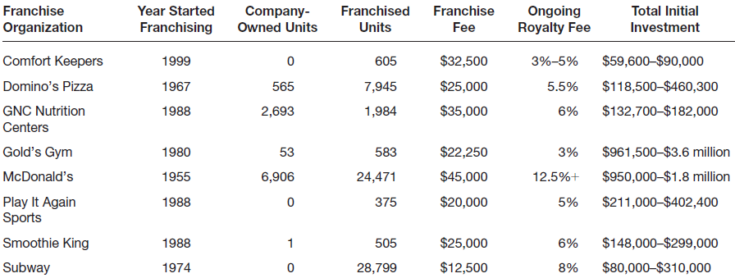
The Costs Involved With Buying a Franchise
3 of 3
Initial Costs to the Franchisee of a Sample of Franchise Organizations
15-<number>

Slide 25
Advantages and Disadvantages of Buying a Franchise
Advantages
Disadvantages
A proven product or service within
an established market.
An established trademark or
business system.
Franchisor’s training, technical
support, and managerial expertise.
An established marketing network.
Availability of financing (varies).
Potential for business growth.
Cost of the franchise.
Restrictions on creativity.
Duration and nature of commitment.
Risk of fraud, misunderstandings, or
lack of franchisor commitment.
Poor performance on the part of other
franchisees.
Potential for failure.
15-<number>

Slide 26
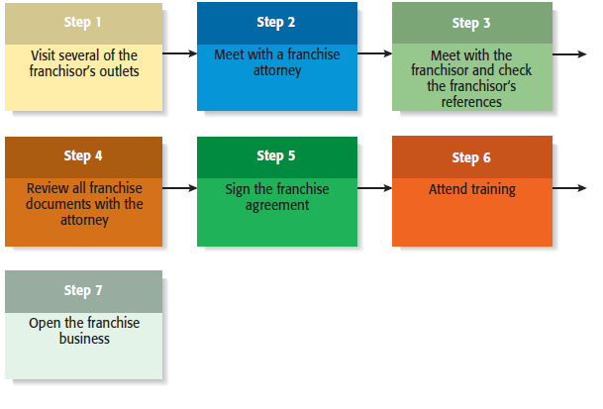
Steps in Purchasing a Franchise
15-<number>

Slide 27
Watch Out! Common Misconceptions About Franchising
Franchising is a safe investment.
A strong industry ensures franchise success.
A franchise is a “proven” business system.
There is no need to hire a franchise attorney or an accountant.
The best systems grow rapidly and it is best to be part of a rapid-growth
system.
I can operate my franchise outlet for less than the franchisor predicts.
The franchisor is a nice person—he’ll help me out if I need it.
15-<number>

Slide 28
Legal Aspects of the Franchise Relationship
Federal Rules and Regulations
  The offer and sale of a franchise is regulated at the federal level.
    According to Federal Trade Commission (FTC) rule 436, franchisors must furnish potential franchisees with written disclosures that provides information about the franchisor, the franchised business, and the franchise relationship.
    In most cases, the disclosures are made through a lengthy document referred to as the Franchisor Disclosure Document (FDD).
    The FDD contains 23 categories of information that give a prospective franchisee a broad base of information about the background and financial health of the franchisor.
15-<number>

Slide 29
More About Franchising
1 of 2
Franchise Ethics
  The majority of franchisors and franchisees are highly ethical.
  There are certain features of franchising, however, the make it subject to ethical abuse. These features are as follows:
    The get rich quick mentality.
    The false assumption that buying a franchise is a guarantee of business success.
    Conflicts of interest between franchisors and franchisees.
15-<number>

Slide 30
More About Franchising
2 of 2
International Franchising
  International opportunities for franchising are becoming more prevalent for the following two reasons:
    The markets for certain franchised products in the U.S. have become saturated (i.e., fast food).
    The trend towards globalization continues.
  Steps to take before buying a franchise overseas:
    Consider the value of the franchisor’s name in the foreign country.
    Get a good lawyer.
    Determine whether the product or service is salable in the foreign country.
    Find out how much training and support you will receive from the franchisor.
15-<number>

Slide 31


All rights reserved. No part of this publication may be reproduced, stored in a retrieval system, or transmitted, in any form or by any means, electronic, mechanical, photocopying, recording, or otherwise, without the prior written permission of the publisher. Printed in the United States of America.
Copyright ©2010 Pearson Education, Inc.

